Slide 1
Software Development Internship Program Presentation
A presentation about my first six weeks at S&P Dow Jones Indices
Salvador Villalon
Software Development Intern
S&P Dow Jones Indices / Web Technology Team
August 1, 2018

Slide 2
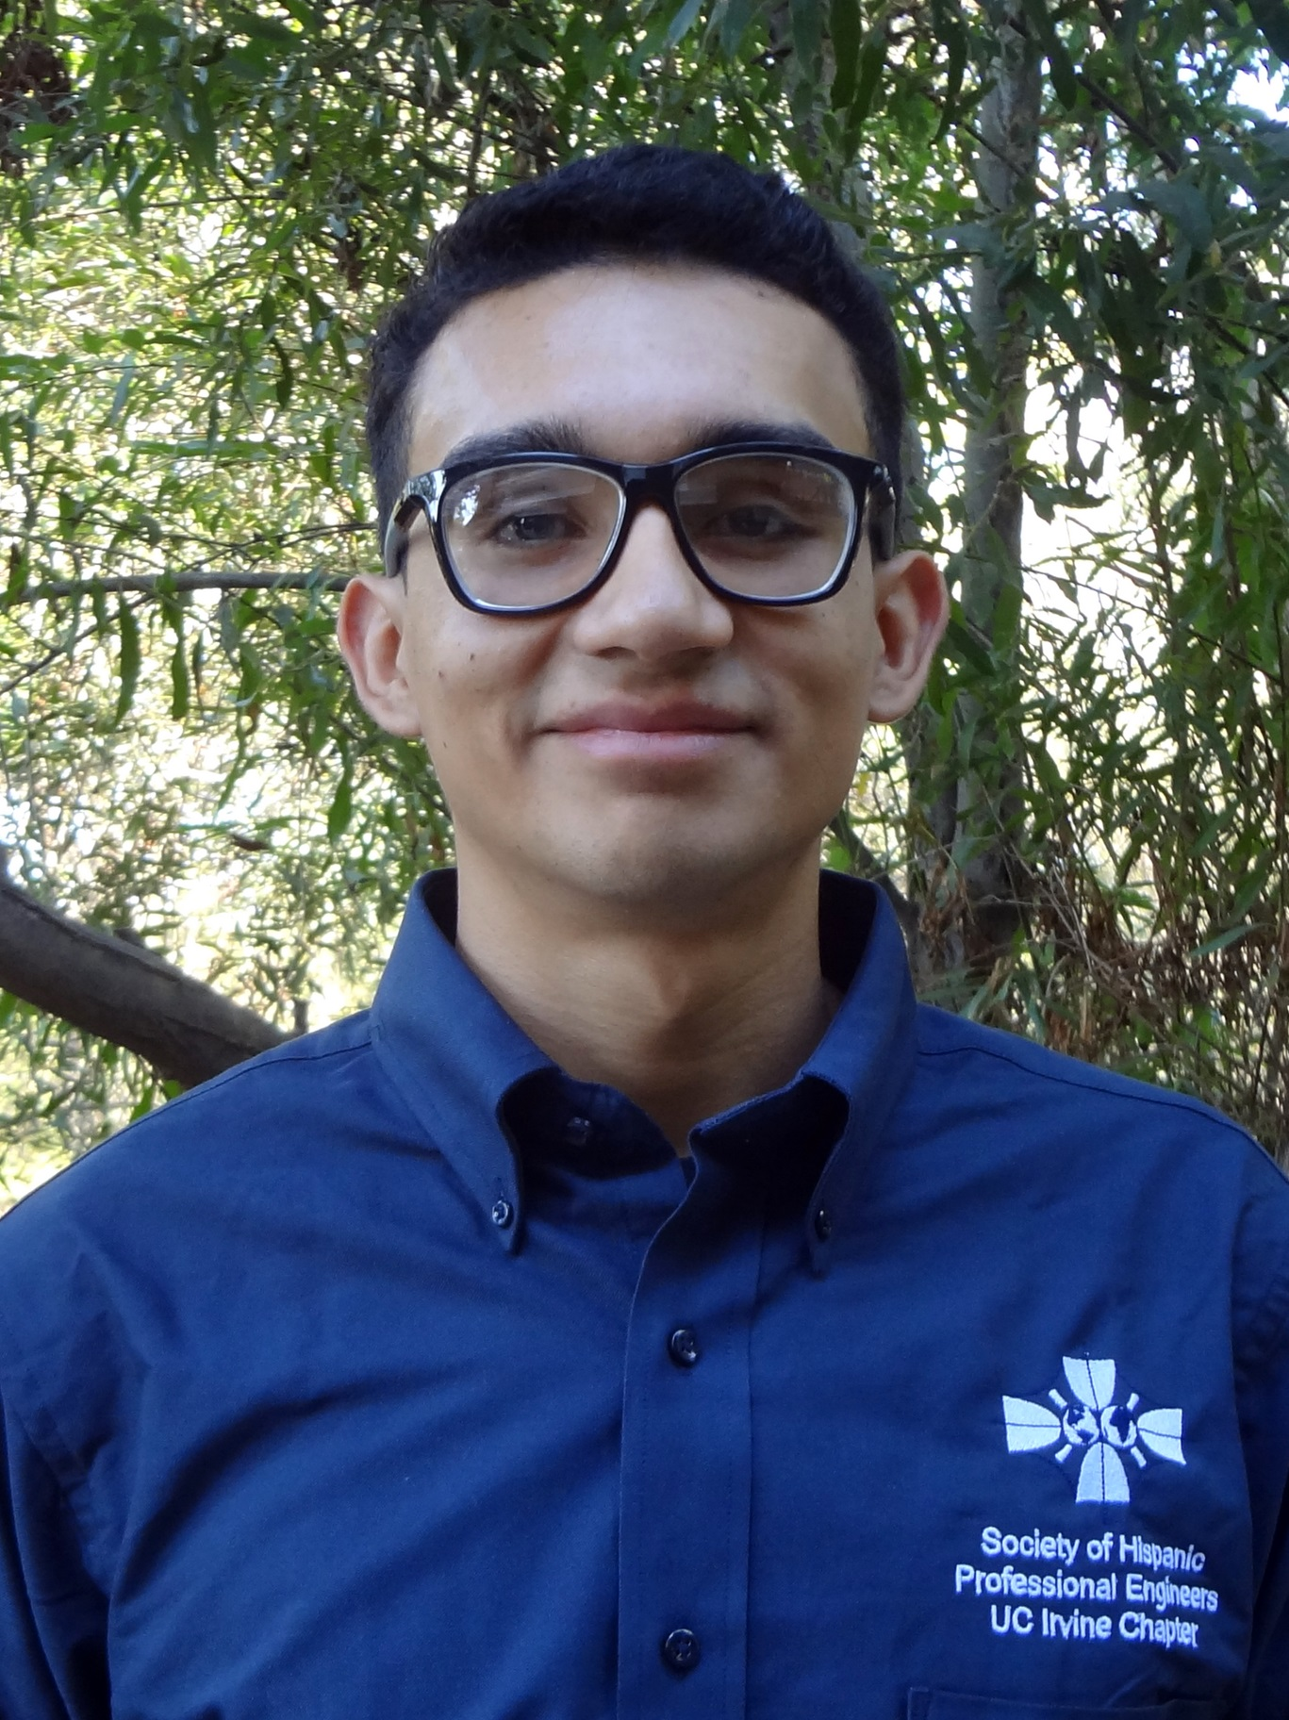

About Salvador Villalon
Name: Salvador Villalon
University: University of California, Irvine
Major: Computer Science
Business Unit: S&P Dow Jones Indices
Team: IT Web Technology Team
Manager: Sharath Srinivas

Slide 3
The Experience

Slide 4
Week 1 & 2

Slide 5
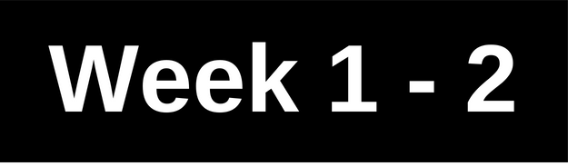


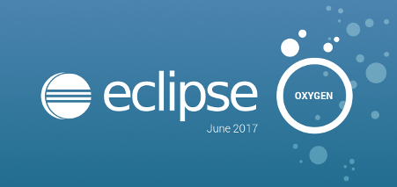
Project 1: Four Enhancements for Vault and IDS Web Platform
The Task
Creating update SQL scripts
Change HTML code for specific files in the platforms
Biggest Takeaway
How to Commit and Push my code to a Team Repository
Git: Not the only revision control system
Importance of requirements
More use of Eclipse
Technologies Used/Learned
Java Server Pages
Git
SVN
GitHub Desktop
Eclipse
Java
Toad for Oracle

Slide 6
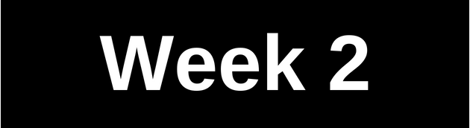



Project 2: Learning about Containers, Open Source Technologies, and Microservices
The Task
Learn about Containers, Open Source Technologies (Docker), Microservices
Run a simple web application on a container
Make a presentation on what I have learned
Biggest Takeaway
Container: a unit that contains everything
needed to run the application
This project opened new opportunities
Technologies Used/Learned
Docker
Microservices
Docker Command Line Tool

Slide 7
Week 3 - 5

Slide 8

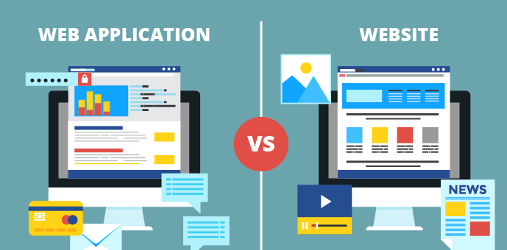

Project 3: Web Applications with Flask (A Python Microframework)
The Task
To better understand of Docker Tutorials,
I decided to learn Flask
Required to run a web application on a container
Biggest Takeaway
What a web application is
Client Side and Server Side
Used Flask as the Server Side Language
Technologies Used/Learned
HTML
CSS
Python
Flask
Web Application
Client Side and Server Side

Slide 9
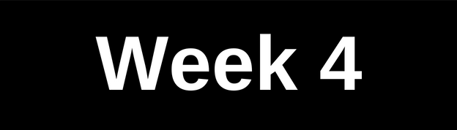

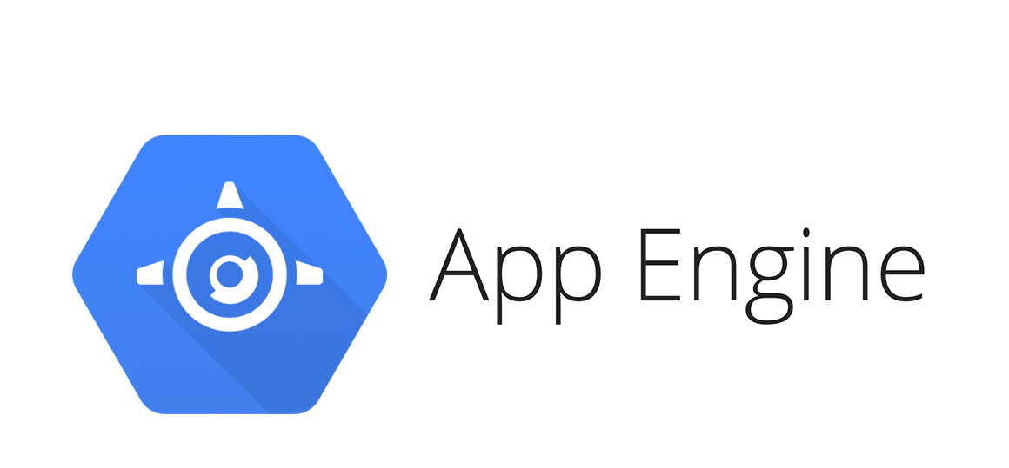
Project 4: Playing with Cloud Services
The Task
After running the two web applications in a container, I
wanted to show others the projects
Cloud services allows me to deploy my web application
Biggest Takeaway
Cloud Services like: Heroku, AWS, Google App Engine, PythonAnywhere
Different process each one takes to deploy a web application
Difference between GitHub Pages and Cloud Services
Technologies Used/Learned
Heroku
AWS
Google App Engine
Git
GitHub

Slide 10
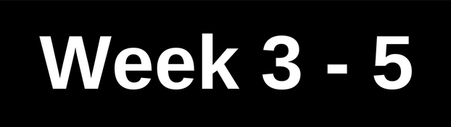


Project 5: Creating a RESTful Client and Using APIs
The Task
Part 1:
Create an enhancement for CARE web platform that allow users to check
if file is locked or not
I used Box RESTful API and was tasked with creating a RESTful client that consumes Box RESTful api
Part 2:
Create a Java class to represent the error that Box API returns when there is an error with the file
In this project, I used my Spanish speaking and writing skills to collaborate with Developers from S&P Global Mexico City office
Continue on next slide
RESTful API

Slide 11


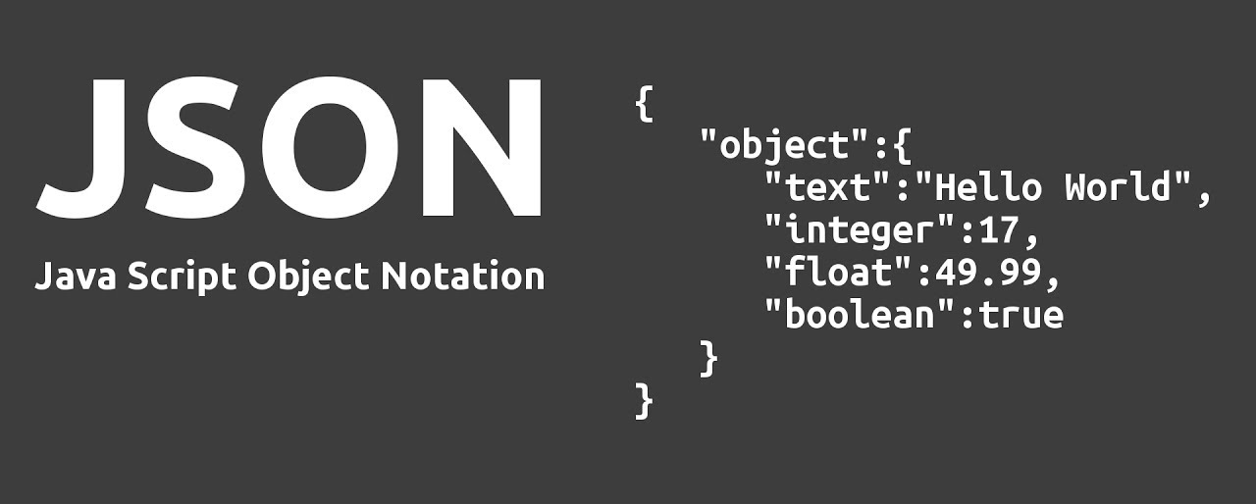
Project 5: Creating a RESTful Client and Using APIs
Biggest Takeaway
Application Programming Interface (API)
API part of the server that receives requests and send responses
A company offers an API it means that they have built a set of URLS that return data
RESTful APIs
APIs that conform with REST architectural Style
JavaScript Object Notation (Json)
Lightweight data-interchange format
Spring Framework
Application development framework for Java
Used to make RESTful client
Postman
A tool to test REST methods on RESTful APIs
Technologies Used/Learned
Eclipse
Postman
Box API
Json
Java
Java Spring Framework

Slide 12
Next Steps

Slide 13
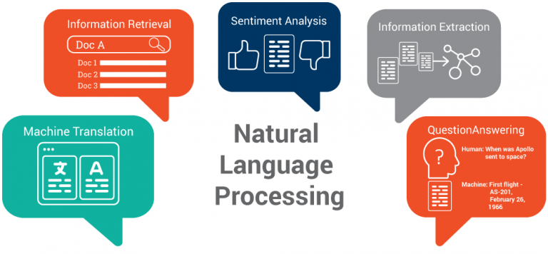

Next Steps
Machine Learning using Python and libraries like NLTK
Finish Docker Presentation
Create a post to help others deploy a Web Application using Flask

Slide 14
Summary

Slide 15
Summary
5 Projects
Technologies Used/Learn
6 Information Interviews with people inside and outside S&P Global
1 Call with a Recruiter from Google
Attended Facebook NYC Intern Summerfest (An Invite Only Event)
Attend Jopwell #SummerUnlocked Networking Event
Eclipse
Postman
Box RESTful API
Java
Spring Framework
Python
Flask
HTML
CSS
Google App Engine
Git
GitHub
Docker
Microservices
Web Application
Client Side and Server Side
Subversion

Slide 16

Thank You
Contact Info
LinkedIn: https://www.linkedin.com/in/salvadorvillalon/
Website: http://salvador-villalon.appspot.com/
Email: salvador.villalon@spglobal.com

